Slide 1

TP557
ADVANCED TOPICS IN IoT AND ML
Institute National of Telecommunications
November 28, 2023

Slide 2


WELCOME TO PRESENTATION
We are Diego and Felipe, and I'll be sharing with you our final project presentation.
For more information, contact us via e-mail: diego.pivoto@dtel.inatel.br and feliperocha@mtel.inatel.br.

Slide 3


ABOUT THEME
Application of Machine Learning (ML) for products inventory control in industrial processes.

Slide 4




Introduction
PRESENTATION OVERVIEW
Related Works
and Methodology
Model Presentation
and Results
Conclusions

Slide 5


INTRODUCTION
EVOLUTION OF INDUSTRIAL PROCESSES
INITIAL INDUSTRIAL REVOLUTION:
Introduction of steam engines and mass production;
EMERGING AUTOMATION:
Evolution towards automated systems for efficiency production;
MANUAL INVENTORY CONTROL:
In early stages, inventory control relied heavily on manual records;
AUTOMATION OF INVENTORY CONTROL:
Advancement to automated inventory control processes;
INTEGRATION OF TECHNOLOGIES:
integration of technologies, including computational vision and Machine Learning (ML) to optimize inventory control in industrial processes.

Slide 6

RELATED WORKS
1 - Product Quality Detection and Recognition based on Vision and Deep Learning;
2 - Vision-based Object Classification using Deep Learning for Inventory Tracking in Automated Warehouse Environment;
3 - Design and simulation robotic arm with computer vision for inspection process;
4 - Real-time monitoring of Conveyor using Computer Vision and IoT;
5 - Machine Monitoring for Industry using Computer Vision.
Projects commonly focused on computation vision and ML techniques without considering support to low cost devices.

Slide 7

HOW TO IMPROVE INDUSTRIAL INVENTORY CONTROL?
— low complexity:
conventional strategies require mathematical and computing complexity to be developed;
— low cost devices:
Need to models supported by devices with low cost and low energy consumption.

Slide 8

METHODOLOGY
A PICTURE IS WORTH A THOUSAND WORDS

Slide 9
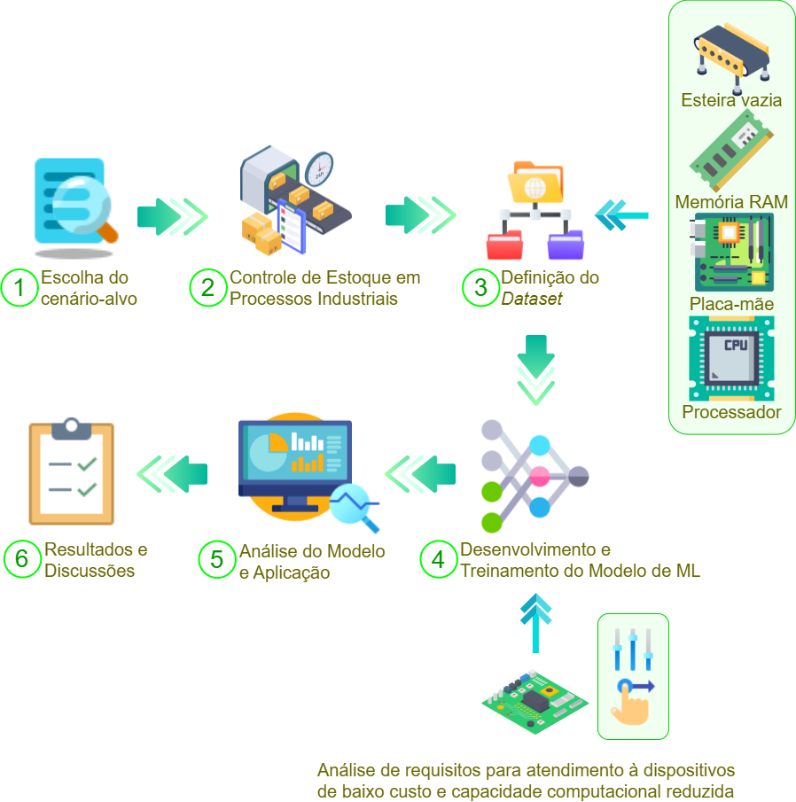

Slide 10
MODEL PRESENTATION
Definition of dataset;
Training and testing model using Edge Impulse tool;
Deploy on devices with low computational capacity.

Slide 11
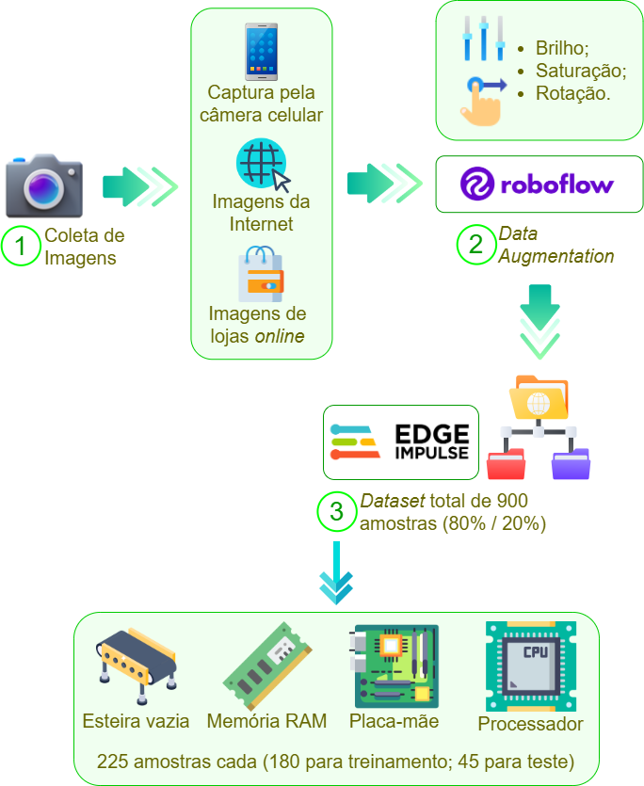
DEFINITION OF
THE DATASET

Slide 12
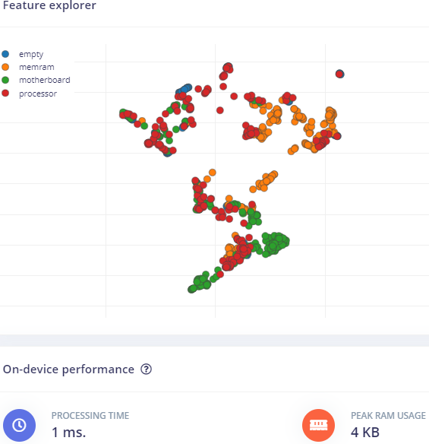
FEATURES OF
THE IMAGES

Slide 13
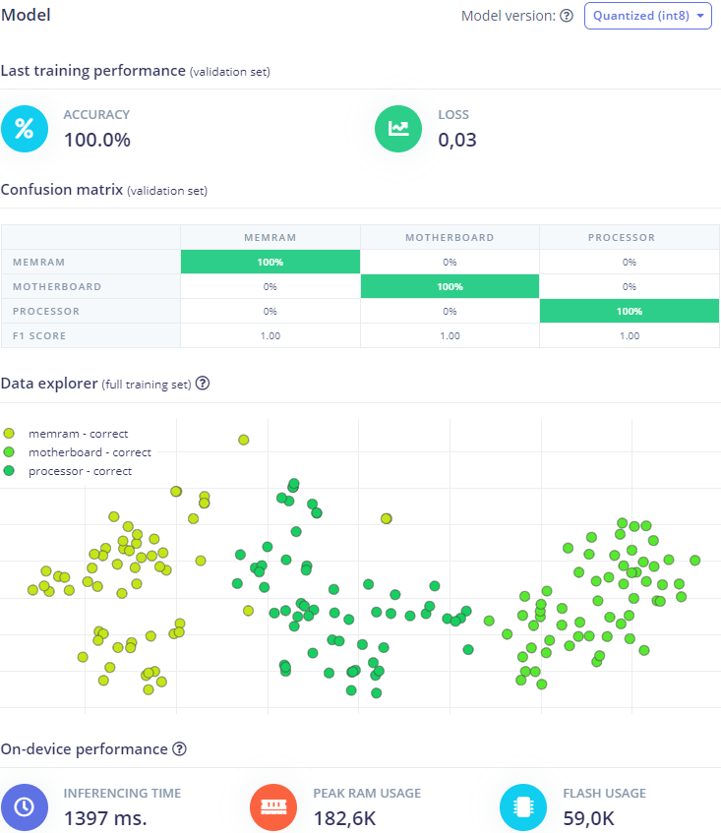
MODEL WITH HIGH INFERENCE TIME

Slide 14

MISSION
VISION
Automatize and optimize the inventory control in industrial proccess using ML.
Equilibrium between low cost devices requirements (RAM, flash) and inference time.

Slide 15
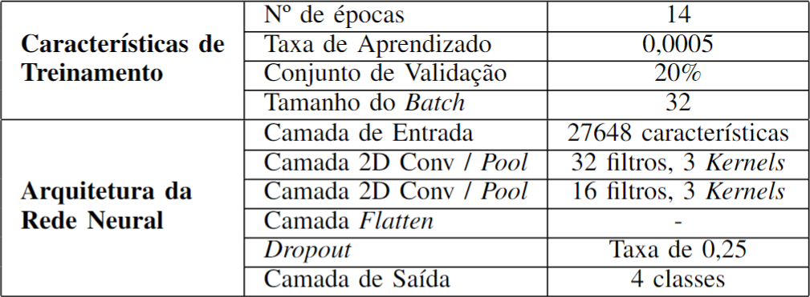
NEURAL NETWORK ARCHITECTURE

Slide 16

STATS & NUMBERS
Results and discussions

Slide 17
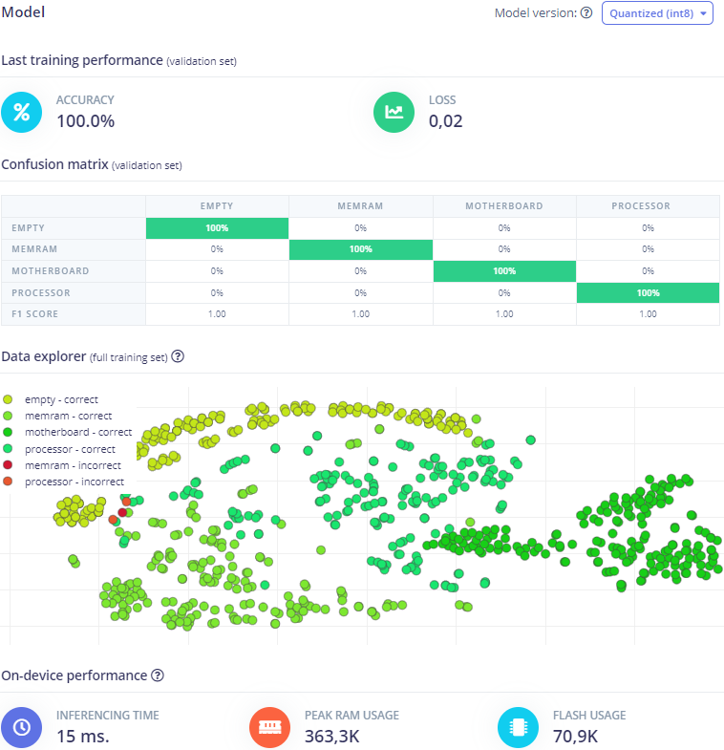
TRAINING PERFORMANCE

Slide 18
1.00
of F1-Score
100.00%
of accuracy
0,02
of loss (categorical cross-entropy)

Slide 19
15 ms
of inference time
363.3K
of peak RAM usage
70.9K
of flash usage

Slide 20
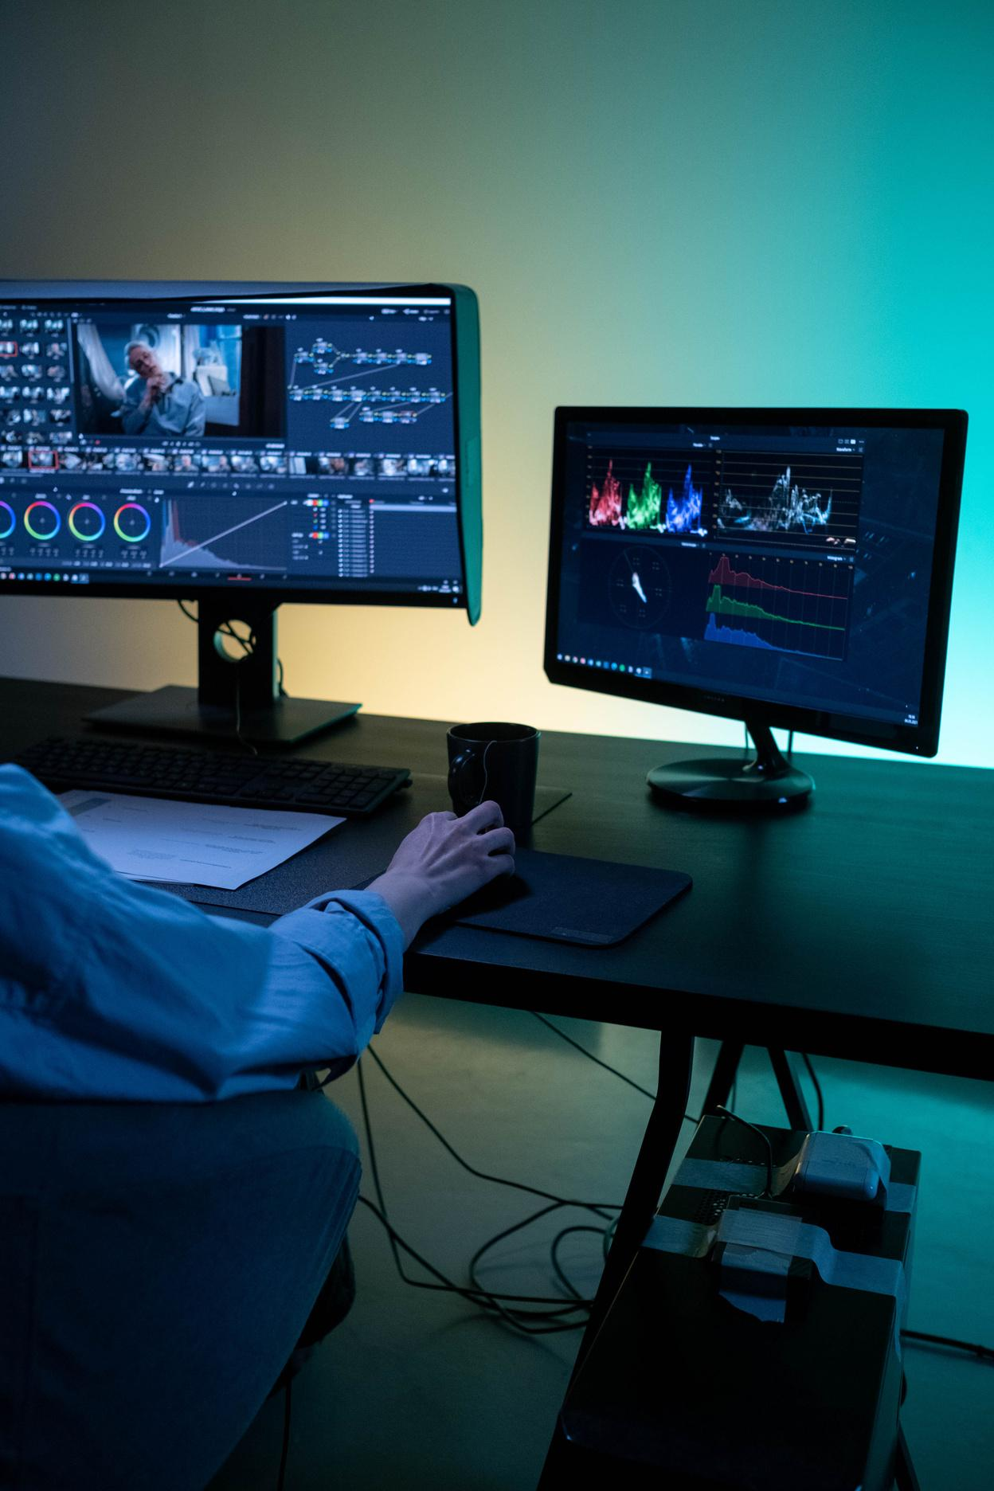

USE CASE
SETTINGS:
Motor DC with power supply of 3.3V for moving conveyor;
Inference through image capture made by cellphone câmera;
Camera positioning for capture images on conveyor.
ML COMBINED TO IoT ARE THE FUTURE!

Slide 21
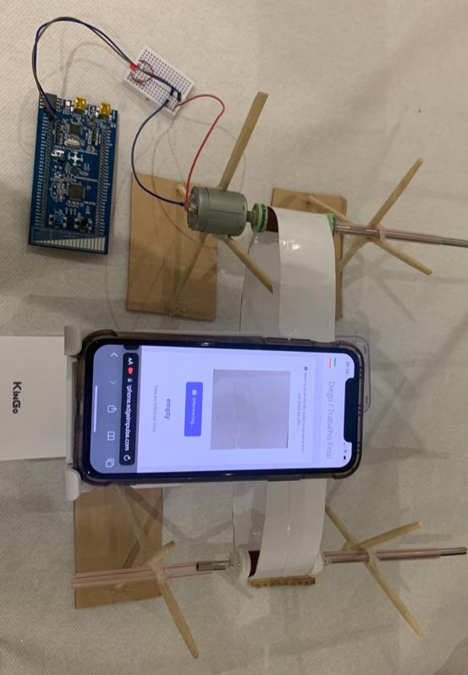
TESTING MODEL ON USE CASE PROPOSAL

Slide 22
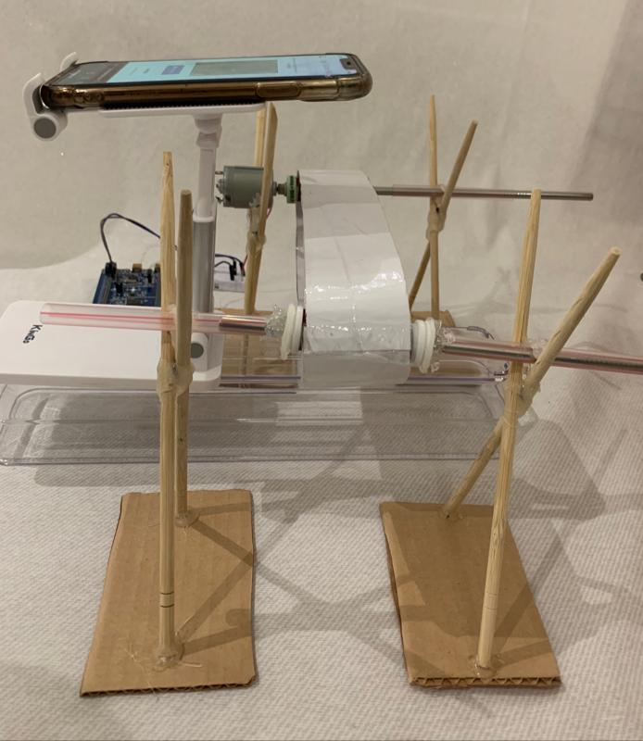
TESTING MODEL ON USE CASE PROPOSAL

Slide 23
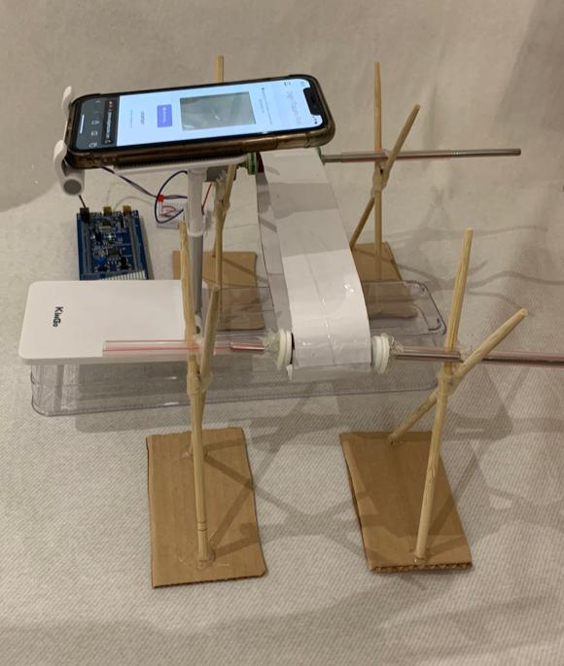
TESTING MODEL ON USE CASE PROPOSAL

Slide 24

VIDEO DEMONSTRATION

Slide 25
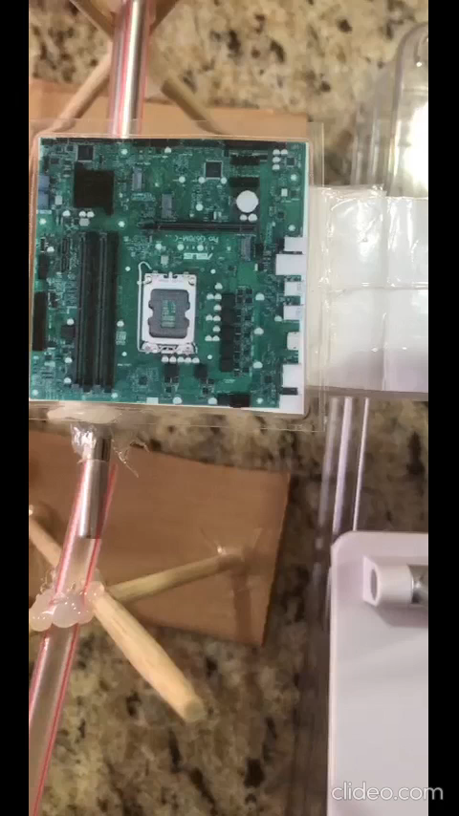

Slide 26
CONCLUSIONS
STRENGTHS | WEAKNESSES | OPPORTUNITIES | THREATS
Low inference time; Reduction of complexity and processing time; Support to low cost and low energy consumption devices. | Support for devices with peak RAM usage above 363.KB; Support for devices with flash usage above 70.9K; Meet requirements for application whose inference time can be 15 ms or more. | Improve neural network parameters; Increase dataset; Optimize model to achieve low RAM and, flash usages, and low inference time; Application of model on real scenario; | How does the developed framework performs as the number of classes and dataset size increase? Is this neural network scalable? What is the performance on different devices?
S
W
O
T

Slide 27

REFERENCES
(For more information about the final project)
GitHub Link of the Final Project:
https://www.github.com/diegogspivoto/TP557
(access link with powerpoint presentation, article, vídeo with tests, and Edge Impulse link with code).
Public Link of Edge Impulse with code:
https://studio.edgeimpulse.com/public/312119/latest
(access link with step-by-step of the ML architecture building, such as dataset, model training and testing).

Slide 28
REFERENCES
(references included in the article)
[1] X. Rao, ”Inventory Management Algorithm and System Implementation Based on Cost Control,” 2023 International Conference on Networking, Informatics and Computing (ICNETIC), Palermo, Italy, 2023, pp. 669-673, doi: 10.1109/ICNETIC59568.2023.00143.
[2] R. Raffik, D. Rakesh, M. Venkatesh and P. Samvasan, ”Supply Chain Control and Inventory Tracking System using Industrial Automation Tools and IIoT,” 2021 International Conference on Advancements in Electrical, Electronics, Communication, Computing and Automation (ICAECA), Coimbatore, India, 2021, pp. 1-5, doi: 10.1109/ICAECA52838.2021.9675774.
[3] Z. Bingqing, ”Classification and inventory control of spare parts based on compound Poisson Demand,” 2020 5th International Conference on Mechanical, Control and Computer Engineering (ICMCCE), Harbin, China, 2020, pp. 681-685, doi: 10.1109/ICMCCE51767.2020.00150.
[4] S. K. UmaMaheswaran, V. K. Nassa, B. P. Singh, U. K. Pandey, H. Satyala and M. K. Chakravarthi, ”An Inventory System Utilizing Neural Network in The Prediction of Machine Learning Techniques,” 2022 2nd International Conference on Advance Computing and Innovative Technologies in Engineering (ICACITE), Greater Noida, India, 2022, pp. 1087-1091, doi: 10.1109/ICACITE53722.2022.9823505.
[5] L. Zhu and P. Spachos, “Towards Image Classification with Machine Learning Methodologies for Smartphones,” Machine Learning and Knowledge Extraction, vol. 1, no. 4, pp. 1039–1057, Oct. 2019, doi: 10.3390/make1040059.

Slide 29
REFERENCES
(references included in the article)
[6] W. Zhengcun and X. Zhongjun, ”.Product Quality Detection and Recognition based on Vision and Deep Learning,” 2020 35th Youth Academic Annual Conference of Chinese Association of Automation (YAC), Zhanjiang, China, 2020, pp. 863-866, doi: 10.1109/YAC51587.2020.9337602.
[7] A. D. Patel and A. R. Chowdhury, "Vision-based Object Classification using Deep Learning for Inventory Tracking in Automated Warehouse Environment," 2020 20th International Conference on Control, Automation and Systems (ICCAS), Busan, Korea (South), 2020, pp. 145-150, doi: 10.23919/ICCAS50221.2020.9268394.
[8] G. Alnowaini, A. Alttal and A. Alhaj, "Design and simulation robotic arm with computer vision for inspection process," 2021 International Conference of Technology, Science and Administration (ICTSA), Taiz, Yemen, 2021, pp. 1-6, doi: 10.1109/ICTSA52017.2021.9406541.
[9] A. Narzary and S. Ashok, "Real-time monitoring of Conveyor using Computer Vision and IoT," 2019 2nd International Conference on Intelligent Computing, Instrumentation and Control Technologies (ICICICT), Kannur, India, 2019, pp. 73-78, doi: 10.1109/ICICICT46008.2019.8993297.
[10] S. S. Chiwande, P. Meshram, A. Charde, S. Bhave and S. Nagdeote, "Machine Monitoring for Industry using Computer Vision," 2022 IEEE Conference on Interdisciplinary Approaches in Technology and Management for Social Innovation (IATMSI), Gwalior, India, 2022, pp. 1-4, doi: 10.1109/IATMSI56455.2022.10119424.

Slide 30
REFERENCES
(references included in the article)
[11] Roboflow, Inc. Roboflow. DisponÍvel em: https://www.roboflow.com. Acesso em: 20 de novembro de 2023.
[12] Edge Impulse, Inc. Edge Impulse. Dispon ́ıvel em: https://www. edgeimpulse.com. Acesso em: 10 de novembro de 2023.
[13] GitHub, Inc. GitHub. DisponÍvel em: https://www.github.com. Acesso em: 22 de novembro de 2023.

Slide 31






CONTACT US
510, Av. João de Camargo, Centro
Santa Rita do Sapucaí, MG, 37540-000
+55 35 99754-4642
diego.pivoto@dtel.inatel.br
feliperocha@mtel.inatel.br
@pivotodiego
https://www.linkedin.com/in/diego-pivoto-4b9b17145/
https://www.linkedin.com/in/felipe-rocha-327493149/

Slide 32
THANK YOU!
Do you have any question(s)?

